Slide 1
RAHUL
TravelTide Customer Segments Analysis

Slide 2
Abstract of TravelTide Customer Segment Analysis
Hello everyone, Today, I'm here to share an exciting journey through data and insights that can help our business thrive. Imagine data as puzzle pieces; we'll put them together to reveal a bigger picture.
We started by organizing our customer data, making it easier to understand. Then, we looked at customer behaviors and preferences. It's like getting to know your friends better to plan exciting adventures together.
Our journey has five stops: hotel stays, luggage, flights, discounts, and flexible plans. At each stop, we'll discover something special.
For example, we'll find out which customers might love a free hotel meal or a free checked bag. We'll learn how to make travel more appealing for different groups and personalized rewards program that keeps customers returning to the TravelTide platform.
So, let's embark on this data-driven adventure, unlocking insights that will make Elena’s rewards program project to be successful and customers happier.

Slide 3
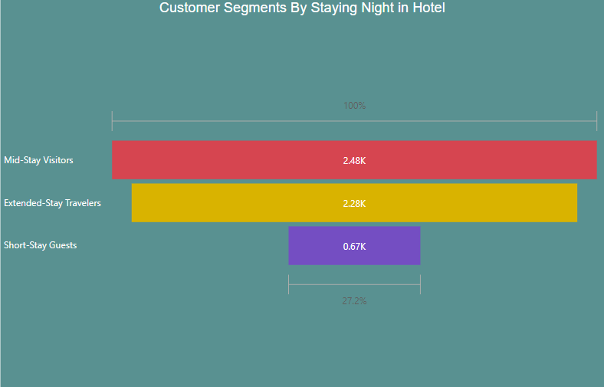
Mid-Stay Visitors and Extended-Stay Travelers:
Prefer longer hotel stays.
Value added benefits during their visit.
Attracted by free hotel meals for convenience.
Short-Stay Guests:
Opt for quick trips and convenience.
May appreciate complimentary breakfast or meals.
Offering a special promotion like "Stay 3 Nights, Get Breakfast Included" can be compelling.
Fig: Customer Segments By Staying Night in Hotel

Slide 4
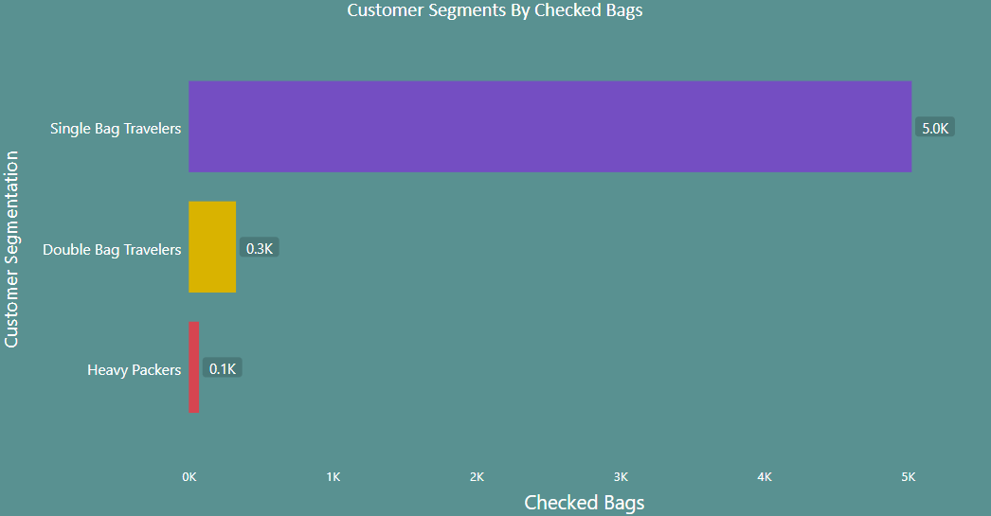
Fig: Customer Segments By Checked Bags
Single Bag Travelers:
Typically travel light with just one bag.
Ideal for promoting free checked bags as a loyalty perk.
Double Bag Travelers:
Frequently check in two bags.
Could benefit from free checked bag services for added convenience.
Heavy Packers:
Travel with multiple checked bags.
Offering free checked bags can cater to their needs and enhance their experience.

Slide 5
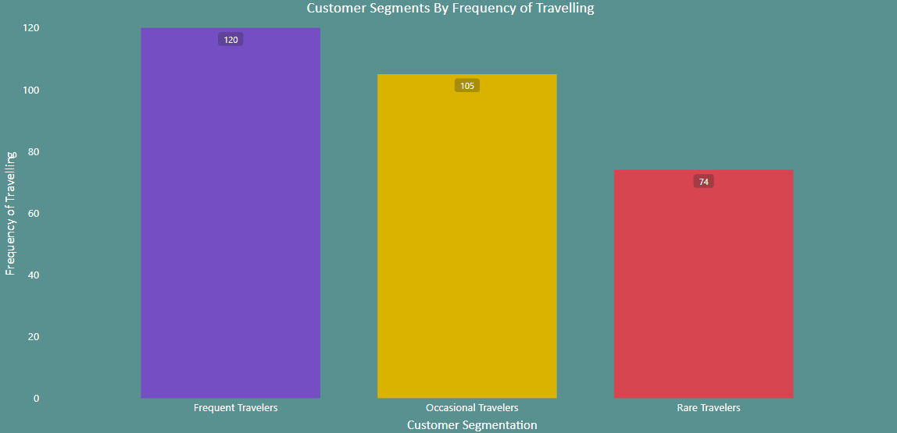
Fig: Customer Segments By Frequency of Travelling
Frequent Travelers:
Travel often, appreciate value-added perks.
Incentivized by a "1 Night Free Hotel with Flight" offer
Occasional Travelers:
Take infrequent trips, prioritize value.
Attracted to vacation packages with a free hotel night.
Rare Travelers:
Infrequent travelers seeking special offers.
A free hotel night can make their occasional trips more appealing.

Slide 6
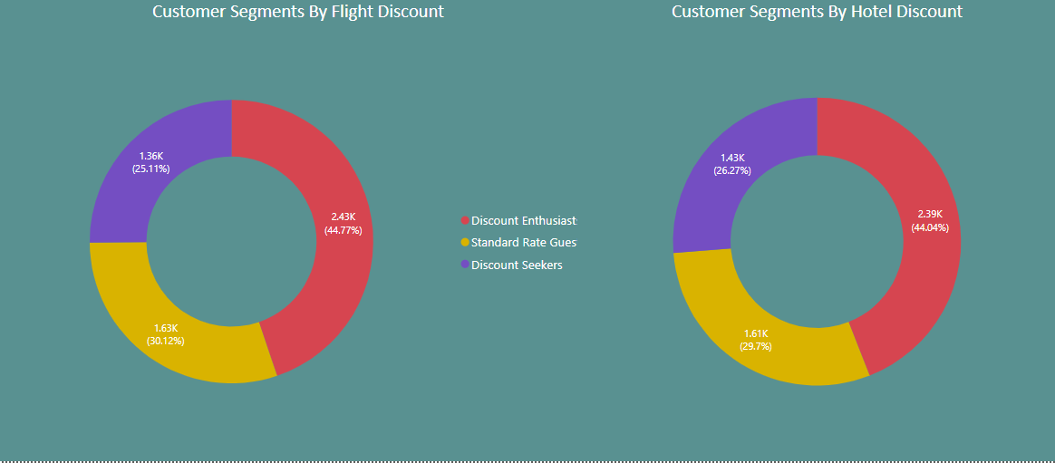
Fig: Customer Segments By Flight Discount & Hotel Discount
Discount Enthusiasts:
Actively seek substantial savings.
Attracted to exclusive discounts and promotions.
Discount Seekers:
Appreciate moderate savings.
Respond positively to exclusive discounts and offers.
Standard Rate Guests:
Typically book at regular prices.
May choose based on quality and competitive pricing.

Slide 7
Frequent Travelers:
Have dynamic schedules, value flexibility.
Find value in no cancellation fees or flexible booking options.
Occasional Travelers:
Travel less frequently, seek flexibility.
Attracted to promotional perks like no cancellation fees.
Rare Travelers:
Rare travelers seeking cost-effective options.
No cancellation fees offer peace of mind for occasional trips.
Fig: Customer Segments By Frequency of Travelling

Slide 8
Thank You for your patience

